Slide 1


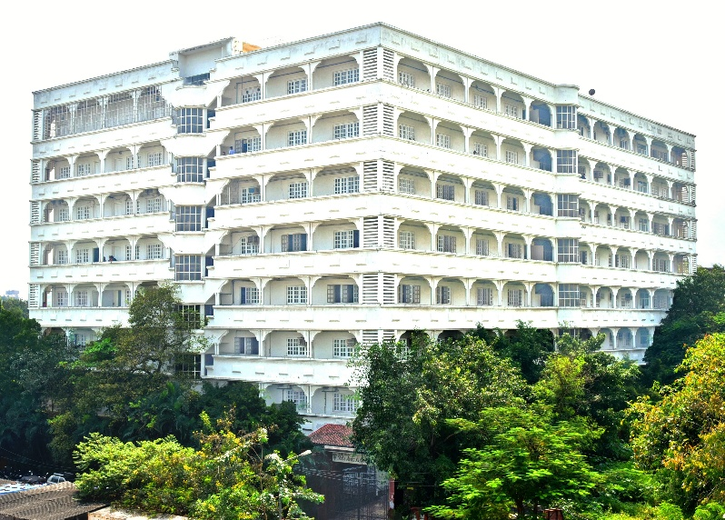
Mahavir Education Trust’s
Shah & Anchor Kutchhi Engineering College
Chembur, Mumbai-400088
(An Autonomous Institute Affiliated to University of Mumbai)
Department of Cyber Security
presentation
on
The Role of Artificial Intelligence in Advanced Digital Forensics
(Subject:Advanced Digital Forensics HNCSCR0701 )
by
(Priya Gaglani 23UF18027CM016)
Email: priya.18027@sakec.ac.in

Slide 2
Vision & Mission
Institute Vision
Department Vision
To be a high repute focused department preparing students ethically in field of cyber security and make them capable to lead technical, economic, social and ethical development of the society.
To become a globally recognized institution offering quality education and enhancing professional standards
Institute Mission
Department Mission
To impart high quality technical education to the students by providing an excellent academic environment, well - equipped laboratories and training through motivated teachers.
1. To provide an academic environment for the development by providing training and skill development to build knowledge, skills, values, and confidence to take a leadership role in the field of Cyber Security.
2. To cultivate research and entrepreneurship culture resulting in knowledge and innovative technologies that contribute to sustainable development of the society.
3. To enhance academic and corporate collaborations.

Slide 3
Program Specific Outcomes
Index | Outcome
PSO1 | The Cyber Security graduates are able to gain a thorough understanding of the Cyber Security landscape with its growing threats and vulnerabilities in the world of computing including software and hardware.
PSO2 | The Cyber Security graduates are able to attain skills to comprehend and anticipate future challenges and devise methods to meet them and also, be articulate and skilled to convince all the stakeholders
PSO3 | The Cyber Security graduates are able to acquire and demonstrate the ability to use ethical standard tools, practices and technologies for the analysis, design, development, implementation and testing of innovative and optimal Cyber Security solutions without compromising the privacy needs of individual and entities and the security concerns of law enforcement agencies.

Slide 4
Outline
Introduction
Problem Statement & Objectives
Core Concept / Theory
Working / Mechanism
Functional & Non-Functional Requirements (if applicable)
Challenges / Limitations
Case Study / Example
Comparative Analysis (if applicable)
Tools & Modeling Approaches
Applications in Real Life
Proposed Framework / Design
Conclusion & Future Scope
Reference

Slide 5
Introduction & Objectives
Digital forensics process
Identify
Collect
Preserve
Examine
Present
AI can assist at this stage
Problem statement
Phones, laptops and cloud accounts hold far more data than an investigator can read by hand.
AI tools can help sort and flag this data, but an unverified AI result can mislead an investigation or weaken the evidence.
Objectives
1. Show where AI supports forensic work
2. Present a workflow that protects evidence
3. Demonstrate rule-based flagging on synthetic data
4. Explain why every AI result needs human verification

Slide 6
AI-Assisted Forensic Workflow
1
Authorised evidence source
2
Evidence preservation & verification
3
Working copy
4
AI-assisted triage & analysis
5
Human verification
6
Documented findings
Preserve first: the original stays untouched
AI supports
People decide and document
AI works on the copy
Analysis runs on a verified working copy, never on the original evidence.
AI output is a lead
Results enter the workflow at step 5 and must be checked before they count.
Everything is recorded
Tool version, settings and steps are documented so others can review the work.

Slide 7
Where AI Helps Investigators
1
Data triage and classification
Helps: Prioritises and groups large file sets and flags likely duplicates.
Check: Confirm the grouping is relevant before relying on it.
2
Detecting unusual activity
Helps: Flags odd login times, file access or data transfers in logs.
Check: An unusual event can have an innocent explanation.
3
Text and multimedia analysis
Helps: Searches messages and documents; speech-to-text and image tools speed up review.
Check: Unclear audio, slang or poor images cause errors. Compare with originals.
4
Connecting evidence
Helps: Relates timestamps, accounts and files across devices and logs to build a timeline.
Check: Similar timestamps do not prove two events are linked.

Slide 8
Synthetic Login-Log Scenario
HYPOTHETICAL DATA: not a real case
Baseline we defined
Normal hours: 08:00 to 17:59
Flag a failed login if the same user has 3 or more failures
IPs are reserved documentation addresses
Time | User | Source IP | Result
02:41:12 | user_d | 198.51.100.7 | SUCCESS
02:41:50 | user_c | 203.0.113.5 | FAILED
02:42:03 | user_c | 203.0.113.5 | FAILED
02:42:17 | user_c | 203.0.113.5 | FAILED
09:12:05 | user_a | 192.0.2.10 | SUCCESS
09:45:30 | user_b | 192.0.2.11 | SUCCESS
10:03:18 | user_c | 192.0.2.12 | SUCCESS
11:20:44 | user_b | 192.0.2.11 | SUCCESS
14:05:09 | user_a | 192.0.2.10 | SUCCESS
16:30:00 | user_a | 192.0.2.10 | SUCCESS
Unusual is not unauthorised
A flag only says: look here first. A night-shift admin or a user in another time zone could produce the same pattern.
Shaded rows = flagged by the baseline rules on the next slide

Slide 9
Rule-Based Flagging in Python
from collections import Counter
# logs = the 10 records from the previous slide
NORMAL_START, NORMAL_END = 8, 18
MAX_FAILURES = 3
failed = Counter(user for t, user, ip, result in logs
if result == "FAILED")
flagged = 0
for t, user, ip, result in logs:
reasons = []
hour = int(t[:2])
if hour < NORMAL_START or hour >= NORMAL_END:
reasons.append("OFF_HOURS")
if result == "FAILED" and failed[user] >= MAX_FAILURES:
reasons.append("REPEATED_FAILS")
if reasons:
flagged += 1
print(t, user, ip, result, "|", ", ".join(reasons))
print(flagged, "of", len(logs), "events flagged for human review")
In plain English
Baseline: NORMAL_START, NORMAL_END and MAX_FAILURES are the rules we set in advance.
Counter: counts how many failed logins each user has.
The loop: checks every record against both rules and collects the reasons.
Output: only flagged rows are printed, for a person to review.
Rule-based flagging, not machine learning.
A teaching example, not a forensic tool.

Slide 10
From Alert to Conclusion
Output (script run and checked)
02:41:12 user_d 198.51.100.7 SUCCESS | OFF_HOURS
02:41:50 user_c 203.0.113.5 FAILED | OFF_HOURS, REPEATED_FAILS
02:42:03 user_c 203.0.113.5 FAILED | OFF_HOURS, REPEATED_FAILS
02:42:17 user_c 203.0.113.5 FAILED | OFF_HOURS, REPEATED_FAILS
4 of 10 events flagged for human review
From alert to conclusion
AI or rule alert
What the tool flags
Investigative lead
Worth a closer look
Possible innocent reasons
On-call or night-shift work
Staff working from another location
A user who forgot a password
What adds concern
Three failures in about 30 seconds
An IP not seen elsewhere in the log
Needs checking: user_c logs in at 10:03 from a different IP
Verify
Check original evidence and context
Documented conclusion
Written, explained, reviewable

Slide 11
Evidence Integrity: Hash Check
Original evidence
login_log_v1
1b7db09ec731cc83…
Reference value, recorded at acquisition
SHA-256
Working copy A
login_log_v1
1b7db09ec731cc83…
MATCH: contents identical to the reference
SHA-256
Working copy B
login_log_v2
b83c2b08ff4b5af2…
MISMATCH: investigate before using
SHA-256
Changing one character gives a completely different hash. Only the first 16 of 64 hex characters are shown.
A matching hash shows the contents are unchanged. It does not prove the original was authentic or that chain of custody was kept.

Slide 12
Benefits, Risks & Safeguards
Manages large data volumes
Surfaces patterns that are easy to miss
Applies the same process consistently
Concern | Why it matters | Safeguard
False positives / negatives | Harmless events get flagged; relevant evidence can be missed | Verify key findings against source evidence; use a second method where practical
Privacy | Devices hold personal data unrelated to the case | Stay within legal authorisation; limit access to sensitive data
Explainability | Some tools cannot show why they flagged an item | Use tools that log operations; explain the method in the report
Evidence integrity | Careless analysis could alter or weaken evidence | Work on verified copies; keep hashes and custody records
Bias and manipulation | Weak results on unfamiliar data; misleading inputs | Test and validate tools; keep human review
Human oversight | AI cannot establish that a crime occurred | Investigator interprets, decides and documents tool, settings and steps

Slide 13
Future Scope & Conclusion
Future scope
Evidence is spreading across phones, cloud services, connected devices and networks, so AI will help compare sources.
More automation means transparent methods, independent validation and careful data handling matter more.
Investigators still need technical knowledge, critical thinking and judgement.
Conclusion
AI helps organise data, flag unusual activity, analyse text and media, and suggest links between events.
Its output must be verified, and evidence must be preserved and documented.
An AI alert is a lead, not a conclusion.

Slide 14
References
[1] Priya. Gaglani, “The Role of Artificial Intelligence in Advanced Digital Forensics,” ADF SLA 1 article. (primary source).
[2] K. Kent, S. Chevalier, T. Grance and H. Dang, Guide to Integrating Forensic Techniques into Incident Response, NIST SP 800-86, Aug. 2006. https://doi.org/10.6028/NIST.SP.800-86
[3] B. Guttman, D. R. White, S. Williams and T. Walraven, Digital Evidence Preservation: Considerations for Evidence Handlers, NIST IR 8387, Sep. 2022. https://doi.org/10.6028/NIST.IR.8387
[4] NIST, Secure Hash Standard (SHS), FIPS 180-4, Aug. 2015. https://doi.org/10.6028/NIST.FIPS.180-4
[5] Python Software Foundation, “hashlib” and “collections.Counter,” Python 3 documentation. https://docs.python.org/3/library/hashlib.html
[6] J. Arkko, M. Cotton and L. Vegoda, IPv4 Address Blocks Reserved for Documentation, RFC 5737, Jan. 2010. https://www.rfc-editor.org/rfc/rfc5737
Slides 5–7 and 12–13 follow my SLA 1 article [1]. Slides 8–11 (scenario, code, hash example) are original demonstration material on synthetic data, supported by [2]–[6].

Slide 15
Thank You

